Slide 1
BP301: An Introduction to Working with the Activity Stream
Mikkel Flindt Heisterberg, OnTime® by IntraVision

Slide 2




@me
Developer for OnTime Group Calendar
Works with IBM Notes, Domino, Sametime, Java, DB2, Websphere Application Server, Web
Lover of plugins – plugins are cool! – but slowly becoming the widget guy
IBM Champion since program inception
Blog: lekkimworld.com
@lekkim

Slide 3
Acknowledgements and Disclaimers
Availability. References in this presentation to IBM products, programs, or services do not imply that they will be available in all countries in which IBM operates.
The workshops, sessions and materials have been prepared by IBM or the session speakers and reflect their own views. They are provided for informational purposes only, and are neither intended to, nor shall have the effect of being, legal or other guidance or advice to any participant. While efforts were made to verify the completeness and accuracy of the information contained in this presentation, it is provided AS-IS without warranty of any kind, express or implied. IBM shall not be responsible for any damages arising out of the use of, or otherwise related to, this presentation or any other materials. Nothing contained in this presentation is intended to, nor shall have the effect of, creating any warranties or representations from IBM or its suppliers or licensors, or altering the terms and conditions of the applicable license agreement governing the use of IBM software.
All customer examples described are presented as illustrations of how those customers have used IBM products and the results they may have achieved. Actual environmental costs and performance characteristics may vary by customer. Nothing contained in these materials is intended to, nor shall have the effect of, stating or implying that any activities undertaken by you will result in any specific sales, revenue growth or other results.
© Copyright IBM Corporation 2014. All rights reserved.
U.S. Government Users Restricted Rights - Use, duplication or disclosure restricted by GSA ADP Schedule Contract with IBM Corp.
IBM, the IBM logo, ibm.com, Lotus, IBM Notes, IBM Domino, and IBM Connections are trademarks or registered trademarks of International Business Machines Corporation in the United States, other countries, or both. If these and other IBM trademarked terms are marked on their first occurrence in this information with a trademark symbol (® or ™), these symbols indicate U.S. registered or common law trademarks owned by IBM at the time this information was published. Such trademarks may also be registered or common law trademarks in other countries. A current list of IBM trademarks is available on the Web at “Copyright and trademark information” at www.ibm.com/legal/copytrade.shtml
Firefox is a trademark of Mozilla
Other company, product, or service names may be trademarks or service marks of others.

Slide 4
What is this session about?
“The future of business is social and the activity stream is the way events and messages are communicated in the social business. In this session you'll learn all there is to know about the activity stream including exactly what it is and how to interact with it using your favorite development environment whether that be JavaScript, XPages, Java or even the plain vanilla HTTP based REST API. This session is for you if you want to start working the Activity Stream.”

Slide 5
Agenda
What’s this session about
What’s the activity stream and what is it not
REST 101
Anatomy of an activity stream post
Posting, working with roll ups and impersonation
Fun and laughter…

Slide 6

The activity stream concept
Activity stream was added in IBM Connections v. 4.0.
“An activity stream is a list of recent activities performed by an individual, typically on a single website. For example, Facebook's News Feed is an activity stream. Since the introduction of the News Feed on September 6, 2006 other major websites have introduced similar implementations for their own users. Since the proliferation of activity streams on websites, there have been calls to standardize the format so that websites could interact with a stream provided by another website.”

Slide 7
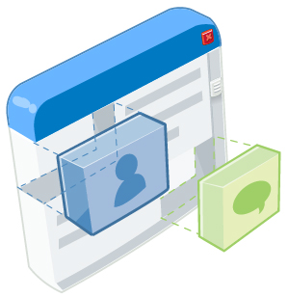

What is the Activity Stream
River of news – it’s like water flowing by you
Notifications about ”stuff” happening in (other) systems – we refer to these notifications as entries
Entries may be saved for future reference and entries may be actionable i.e. indicated that it must be acted upon
Typically you decide what goes into your stream
A replacement for email notifications (although you can have those too...)
Standards based – like – meaning – IBM took the standard and added IBM Connections specific stuff to it

Slide 8
What is the Activity Stream NOT
A new inbox – doesn’t replace email
A perpeptual data store – entries are deleted based on a server defined purge interval (default is 30 days) unless saved or actionable
Meant as a content repository
Something that implies that you must read it all – it’s notifications – treat it as such...
If an entry is ”must read” it should be marked actionable

Slide 9

Demo
Let’s look at the activity stream in IBM Connections
See options for filtering (saved/actionable)

Slide 10
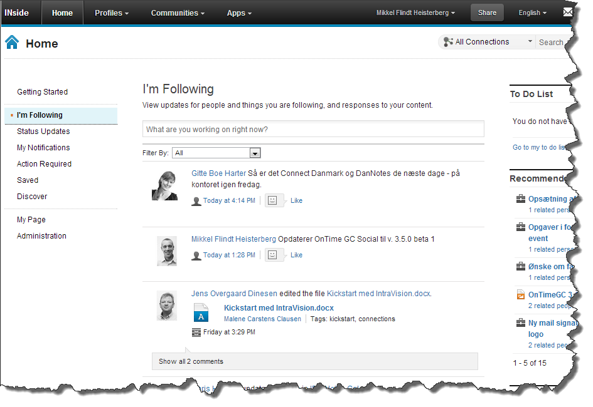
Demo safety slide

Slide 11
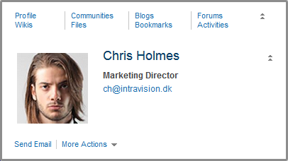
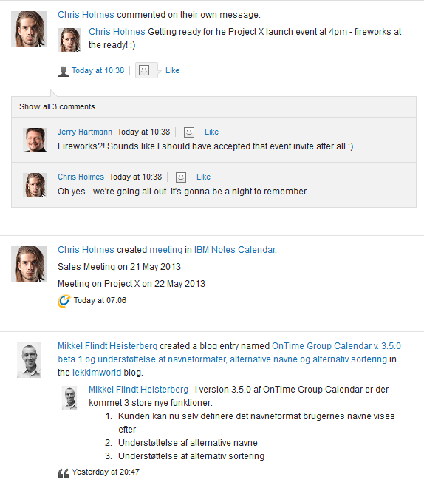
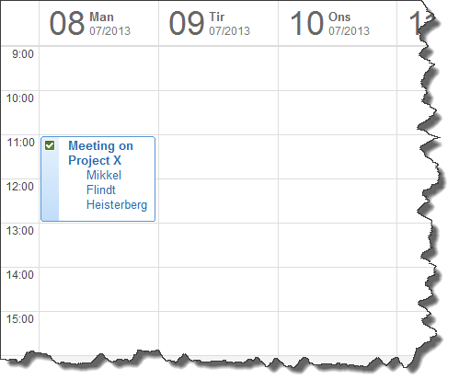

No content stored in the stream

Slide 12
REST API’s 101 (1)
HTTP is much more than what a web browser reveals
The request
has a method (GET, POST, PUT, DELETE)
may have headers that describe the request such as a Content-Type (text/html), cookies and authentication information.
may have a body data
The response
has a return code (200 = OK, 301 = Moved, 404 = Not found)
may carry body data
may have headers that describe the response (e.g. Content-Type, charset and new location)

Slide 13
REST API’s 101 (2)
You will mainly use the POST and PUT methods to send JSON data (Content-Type: application/json) to the API
JSON is super simple key/value data format. It has simple datatypes (strings, numbers, booleans), objects and arrays
{ ”email”: ”mh@intravision.dk”, ”niceGuy”: true, ”age”: 37, ”name”: { ”first”: ”Mikkel Flindt”, ”last”: ” Heisterberg” }, ”Lotuspheres”: [2006, 2007, 2008, 2009, 2010, 2011, 2012], ”IBMConnects”: [2013, 2014] }

Slide 14
REST API’s 101 (3)
HTTP is pure text and easily done using telnet but there are cool tools to make it easier:
RESTClient in Firefox
Advanced REST Client in Chrome
cURL if you’re a command line guy/gal
Standalone REST client
Recommend standalone REST client such as CocoaRESTClient in combination with a proxy such as Charles Web Proxy, http://www.charlesproxy.com

Slide 15
How many streams are there?
In my opinion it makes most sense to not consider the activity stream as one single stream
Instead think that
Each user has his/her own (@me)
There is a public stream (@public)
A community may have a stream if the widget has been added by a community owner – if there’s no stream for a community posting to it will return a ”403 Forbidden”

Slide 16
Stream URL components
https://<host>/connections/opensocial/<auth>/rest/activitystreams /<user ID>/<group ID>/<application ID>/<activity ID>
Component | Meaning
<auth> | (optional) If using form based authentication leave this component out. Otherwise options are anonymos, basic, oauth (last option not covered in this presentation).
<user ID> | The user whose stream you’re addressing – use @me for current users stream, @public for public stream or a community ID for the stream in a community.
<group ID> | The group of entries you’re addressing – use @all for all posts or options for special meaning such as @saved, @actions, @mentions. Refer for InfoCenter and resources slide for more.
<application ID> | When retrieving entries this refers to the application (or ”generator”) that created the entry. All the IBM Connections app names can be used (profiles, blogs, wikis etc.) plus custom ones (e.g. ontimegc). @all used for all applications.
<activity ID> | Used to reference a specific event e.g. for updating saved status.

Slide 17
Stream URL Examples
/activitystreams/@me/@all List my (current users) entries
/activitystreams/@public/@all List public stream entries
/activitystreams/@me/@actions List my actionable events
/activitystreams/@me/@saved/blogs List my saved events from blogs
/@me/@all/@all/urn:lsid:lconn.ibm.com:activitystreams.story:bdb562f…Work with entry from my stream based on ID
Also used
when creating
new entries
(e.g. POSTing)
* All URLs above start with https://<host>/connections/opensocial/<auth>/rest

Slide 18

Anatomy of a stream entry
A stream entry reads like ”the current user posted a note to IBM Connections and you should act on it”

Slide 19
Anatomy of a stream entry
A stream entry reads like ”the current user posted a note to IBM Connections and you should act on it”
The person doing the posting is called the actor and can be a specific user ID but usually the current user (@me)

Slide 20
Anatomy of a stream entry
A stream entry reads like ”the current user posted a note to IBM Connections and you should act on it”
What the person does is called the verb and there’s a long list of predefined ones such as post, update, create...

Slide 21
Anatomy of a stream entry
A stream entry reads like ”the current user posted a note to IBM Connections and you should act on it”
The object in question is called the object and can be anything that represents the target ”thing” i.e. file, note, meeting...

Slide 22
Anatomy of a stream entry
A stream entry reads like ”the current user posted a note to IBM Connections and you should act on it”
The system the user worked on is called the target and can be any system you need to refer to

Slide 23
Anatomy of a stream entry
A stream entry reads like ”the current user posted a note to IBM Connections and you should act on it”
IBM Connections supports some special properties for entries such as actionable and saved to allow users to work with entries

Slide 24
Anatomy of a stream entry
{
"actor": {"id": "@me"},
"verb": "post",
"title": "Some entry title",
"updated": "2013-05-17T12:00:00.000Z",
"object": {
"title": "Some object title",
"objectType": "note",
"id": "1234567890-1234567890-1234567890"
}
}

Slide 25
Anatomy of a stream entry
{
"actor": {"id": "@me"},
"verb": ”create",
"title": ”Sales proposal for Rockets Inc.",
"updated": "2013-05-17T12:00:00.000Z",
"object": {
"title": "Sales proposal for Rockets Inc.",
"objectType": ”proposal",
"id": "1234567890-1234567890-1234567890"
},
”target”: {
”displayName”: ”Acme Corp. CRM”,
”url”: ”https://crm.example.com”
}
}
A stream entry reads like ”the current user posted a file to IBM Connections and you should act on it”
IBM Connections is the implied default target but you can specify your own target in the entry

Slide 26
Posting an entry* to the stream
POST /connections/opensocial/basic/rest/activitystreams/@me/@all Host: social.example.com Content-Type: application/json Content-Length: xyz Authorization: Basic xyz123 { "actor": {"id": "@me"}, "verb": "post”, "title": "Some entry title", "updated": "2013-05-17T12:00:00.000Z”, "object": { "title": "Some object title”, "objectType": "note”, "id": "1234567890-1234567890-1234567890” } }
* Smallest entry you can/should post to the stream

Slide 27
Demo
REST client
Easily work with feeds, authentication, headers etc.
Use proxy to override cookies

Slide 28
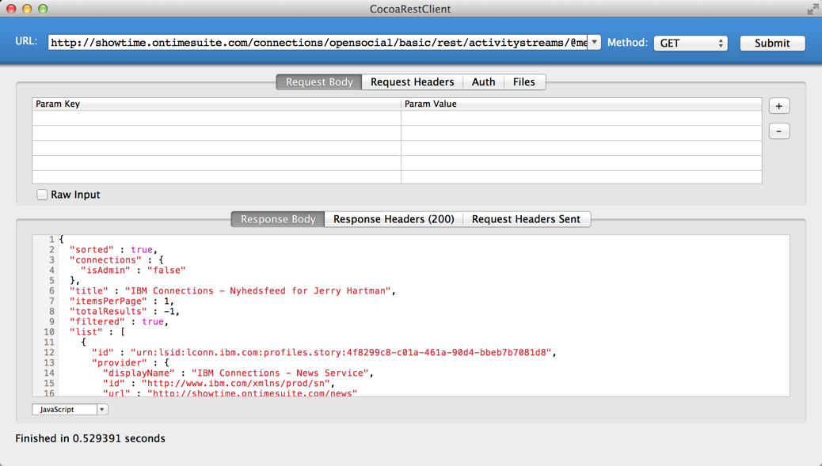
Demo safety slide

Slide 29

Deleting from the stream
In short you can’t – up to IBM Connections v. 4.5 you cannot delete from the activity stream – you’ll just get an 403 Forbidden back
There is some light at the end of the tunnel though – this directly from the developers at IBM: “We are however adding 'propagateDelete' at the moment, which deletes all events related to a given object on receipt of a delete event (if so specified). This will be protected by a trusted role.”

Slide 30
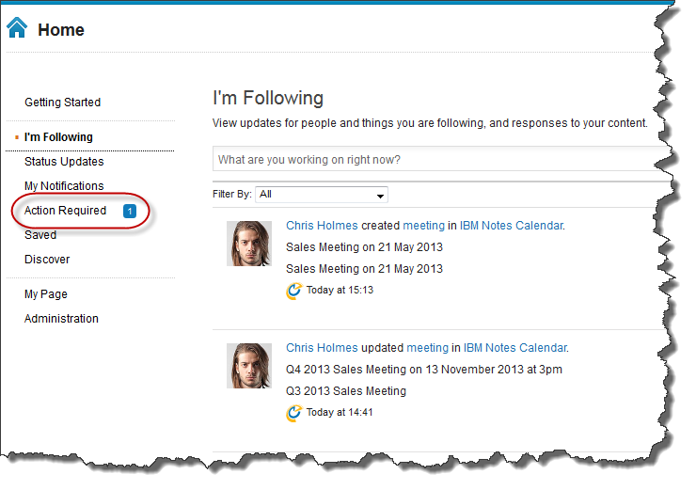
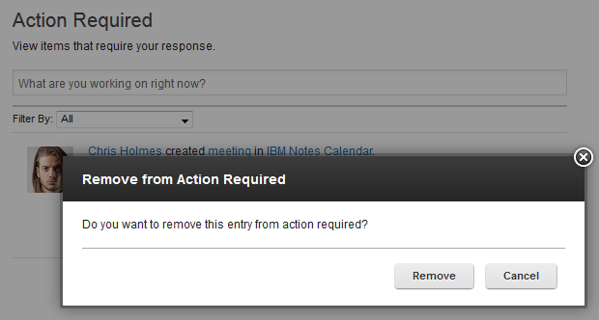
Action required!

Slide 31
Mark/unmark as actionable
GET /connections/opensocial/basic/rest/activitystreams/@me/@actions Host: social.example.com Authorization: Basic xyz123 PUT /connections/.../activitystreams/@me/@all/@all/de325123-e269-4a33-b62a Host: social.example.com Content-Type: application/json Content-Length: xyz Authorization: Basic xyz123 { "actor": {"id": "@me"}, "id": "de325123-e269-4a33-b62a”, "connections": { "actionable": false } }
Response
{"entry": {
"connections": {
"actionable": "false"
},
"id": "unmark actionable:"
}}

Slide 32
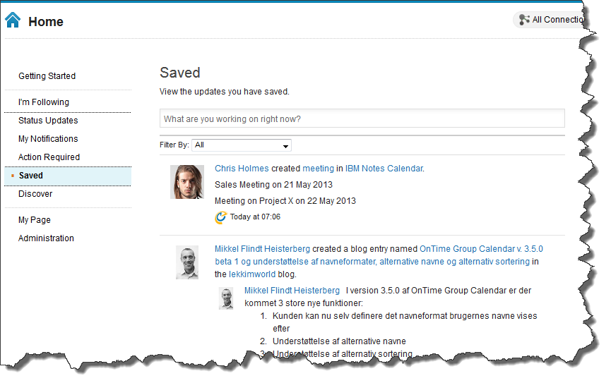
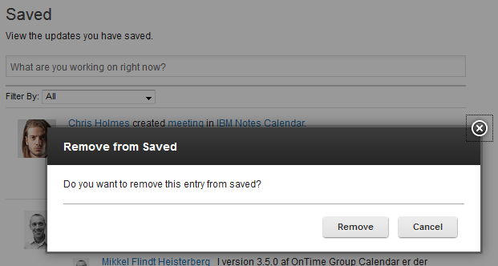
Save for later

Slide 33
Mark/unmark saved
GET /connections/opensocial/basic/rest/activitystreams/@me/@saved Host: social.example.com Authorization: Basic xyz123 PUT /connections/.../activitystreams/@me/@all/@all/de325123-e269-4a33-b62a Host: social.example.com Content-Type: application/json Content-Length: xyz Authorization: Basic xyz123 {
"actor": {"id": "@me"}, "id": "de325123-e269-4a33-b62a”, "connections": { ”saved": false } }
Response
{"entry": {
"connections": {
“saved": "false"
},
"id": "unmark saved:“
}}

Slide 34
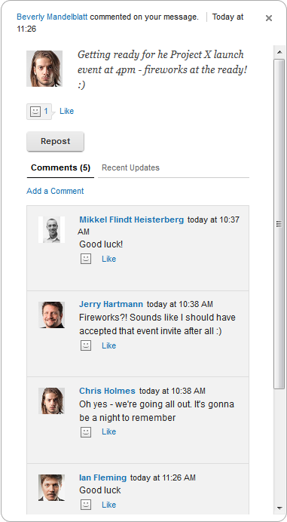
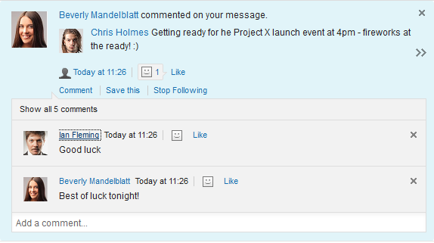
Rolling it up
Rollup is telling the stream that an post/update relates to the same ”thing”
Used to avoid cluttering up the user interface

Slide 35
Rolling it up
POST /connections/opensocial/basic/rest/activitystreams/@me/@all Host: social.example.com Content-Type: application/json Content-Length: xyz Authorization: Basic xyz123 { "actor": {"id": "@me"}, "verb": "post”, "title": "Some entry title", "updated": "2013-05-17T12:00:00.000Z”, "object": {"title": "Some object title”, "objectType": "note”, "id": "1234567890-1234567890-1234567890” }, ”connections”: { ”rollupid”: ”1234567890-1234567890-1234567890” } }

Slide 36
Rollup id vs. Object id
May seem similar but not the same…
Rollup is a way of telling the activity stream that different posts, with different object ids, relate to the same thing i.e. should be rolled into the same post (in the UI)
Posting with the same object id is the same as specifying the object id as the rollup id
In general get into the habit of explicitly using the id of the ”thing” (i.e. the object id) you’re pointing to as the roll up id.

Slide 37
Templates
Two main reasons for looking at templates
Internationalization (i18n) / translation
Getting a standard representation in the UI
Two types of templates
Object Substitution replaces a reference with nice markup – an example is replacing the actor with a HTML reference using the business card
Title Template Substitution – uses object substitutions it makes standard titles

Slide 38
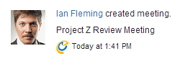


Templates
Object Substitution
${Actor} - this is converted into appropriately marked up HTML which displays the Actors name and links to a Business Card
${Object} - if this is a person we display as with the Actor above, otherwise the displayName with a link to the url
${Target} - if this is a person we display as with the Actor above, otherwise the displayName with a link to the url
Title Template Substitution
${created} = ${Actor} created ${Object}
${create.target} = ${Actor} created ${Object} in ${Target}

Slide 39
Using templates
POST /connections/opensocial/basic/rest/activitystreams/@me/@all Host: social.example.com Content-Type: application/json Authorization: Basic xyz123 { "actor": {"id": ”@me"}, "verb": "create”, "title": "${create}", "updated": "2013-05-21T12:00:00.000Z”, "object": { "summary": "Project Z Review Meeting”, "objectType": "meeting”, "id": "123456789012345678901234567890OP” } }

Slide 40
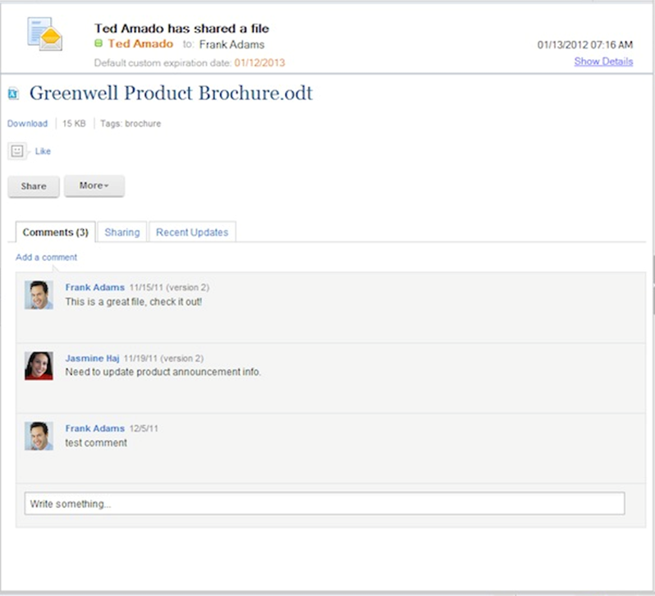
Embedded Experiences
EE works a little different in e-mail and in the activity stream
E-mail
Traditional (SMTP) e-mail is using Multipurpose Internet Mail Extension (MIME)
EE’s adds an additional ”MIME part” – clients in the know will show content based on this data if possible and allowed by policy
Activity stream
Activity stream delivery model is a bit different than in e-mail as we already have a structured payload
Application sending the entry adds an openSocial.embed object to the entry with link to the gadget required for rendering the EE and context info

Slide 41
Embedded Experiences
{ ”actor”: {”id”: ”@me”}, … … "openSocial": { "embed": { "gadget": http://ee.example.com/mygadget.xml, "context": {"id":"12345”} } } }

Slide 42

Posting to other users stream
By default you may only post entries to your own activity stream
Sending to others can be considered as spam
As with standards there are multiple ways of doing it using either
OpenSocial (openSocial: {deliverTo: []})
Activitystrea.ms (to: [])
Just use the second one...
To send to another users stream you need to either be him/her or be a trusted application (more information later...)

Slide 43
Posting to other user
{ "actor": {"id": "@me"}, "to": [{"objectType": "person", "id": "A7E718F4-3040-2A00-C125"}], "verb": "create”, "title": "${create}", "updated": "2013-05-21T12:00:00.000Z”, "object": { "summary": "Project X Review Meeting”, "objectType": "meeting”, "id": "123456789012345678901234567890MN” }, "connections": { "rollupid": "123456789012345678901234567890MN”, } }

Slide 44
Posting as other user
{ "actor": {"id": "A7E718F4-3040-2A00-C125"}, "to": [{"objectType": "person", "id": "A7E718F4-3040-2A00-C125"}], "verb": "create”, "title": "${create}", "updated": "2013-05-21T12:00:00.000Z”, "object": { "summary": "Project Y Review Meeting”, "objectType": "meeting”, "id": "123456789012345678901234567890OP” }, "connections": { "rollupid": "123456789012345678901234567890OP” } }

Slide 45
Posting to & as other user
{ "actor": {"id": "1E7F44DD-9C20-842A-C125"}, "to": [{"objectType": "person", "id": "A7E718F4-3040-2A00-C125"}], "verb": "create”, "title": "${create}", "updated": "2013-05-21T12:00:00.000Z”, "object": { "summary": "Project Z Review Meeting”, "objectType": "meeting”, "id": "123456789012345678901234567890OP” }, "connections": { "rollupid": "123456789012345678901234567890OP” } }

Slide 46
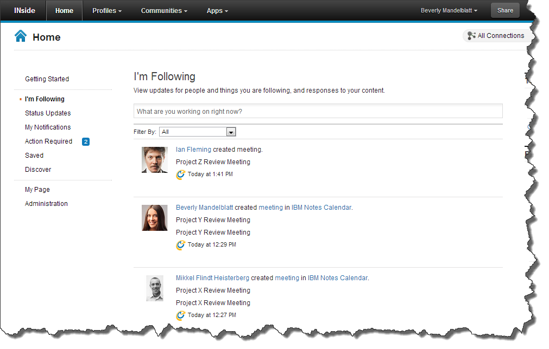
How it looks in the UI

Slide 47
How it looks in the UI
Oh!! Look at
that pretty
icon!

Slide 48
Using a generator
{
"generator": {"id": ”ontimegc", "image”: "http://www.ontimesuite.com/favicon.ico", "displayName": ”OnTime Group Calendar", "url": "http://www.ontimesuite.com" }, "actor": {"id": "@me"}, "verb": "post”, "title": "Some entry title", "updated": "2013-05-17T12:00:00.000Z”, "object": { "title": "Some object title”, "objectType": "note”, "id": "1234567890-1234567890-1234567890” } }

Slide 49
Using a predefined generator
{
”generator": {"id": ”ontimegc"}, "actor": {"id": "@me"}, "verb": "post”, "title": "Some entry title", "updated": "2013-05-17T12:00:00.000Z”, "object": { "title": "Some object title”, "objectType": "note”, "id": "1234567890-1234567890-1234567890” } }

Slide 50
Registering generators
wsadmin>execfile("newsAdmin.py")
wsadmin>NewsActivityStreamService.listApplicationRegistrations()
{wikis=wikis, communities=communities, general=General, profiles=profiles, activities=activities, homepage=homepage, blogs=blogs, forums=forums, files=files, dogear=dogear, demoapp=Demo Application, kudos=Kudos}
wsadmin>NewsActivityStreamService.registerApplication("ontimegc", "OnTime Group Calendar", "http://www.ontimesuite.com", "", ”http://inside.intravision.dk/images/ontime.gif”, ””, ”OnTime Group Calendar”, ”true”)
wsadmin>
After first use of a generator it can be referenced by ID. Purpose of registering is that users may filter by it in the UI.

Slide 51
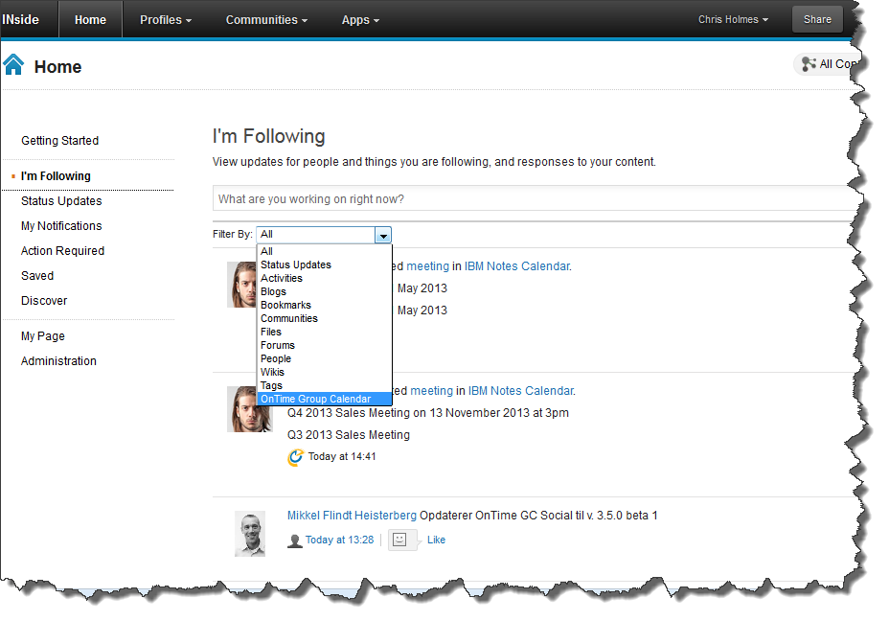
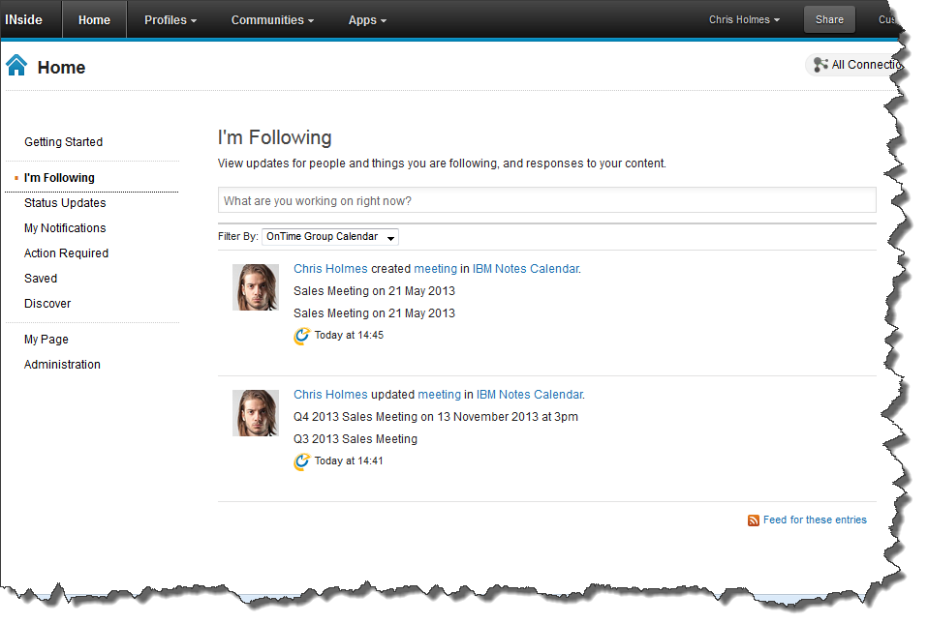
Benefit of registering generator

Slide 52
Granting access (1)
Permission to send to other users are granted using the trustedExternalApplication role
Granted in the WidgetContainer application using wsadmin or the Websphere Application Server Integrated Solutions Console – the latter is easiest

Slide 53
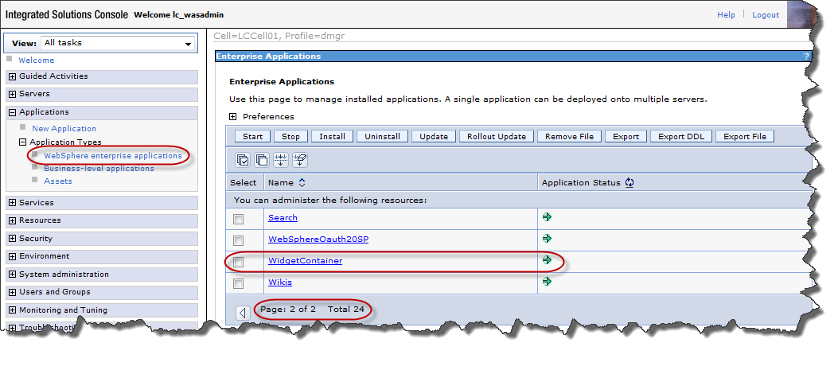
Granting access (2)

Slide 54
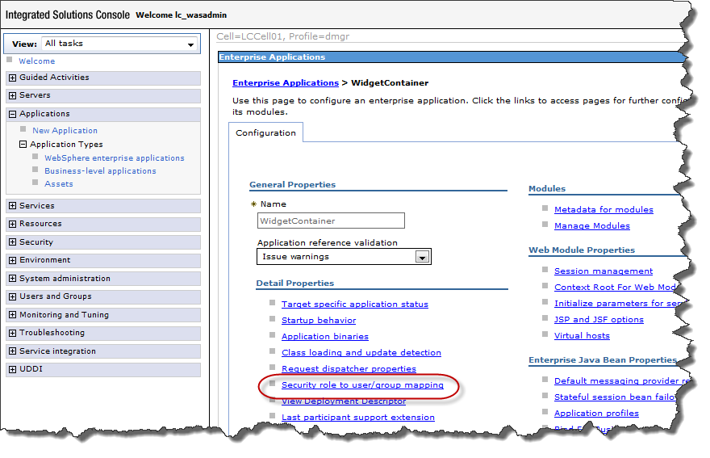
Granting access (3)

Slide 55
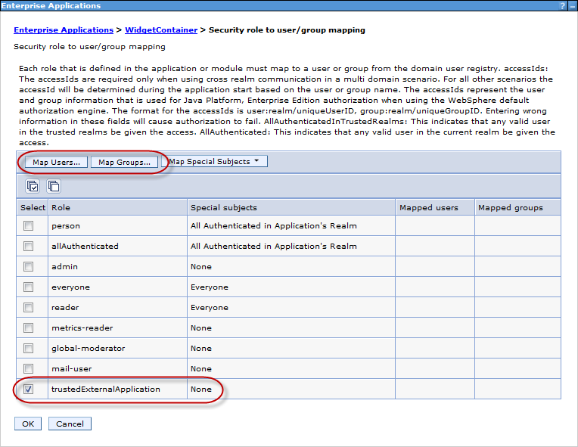
Granting access (4)

Slide 56
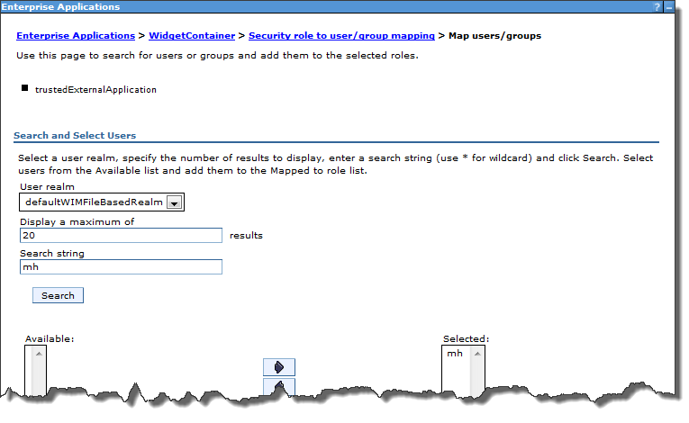
Granting access (5)

Slide 57
Demo
Tweet’2’stream
https://github.com/lekkimworld/IC14_BP301
Build script integration

Slide 58
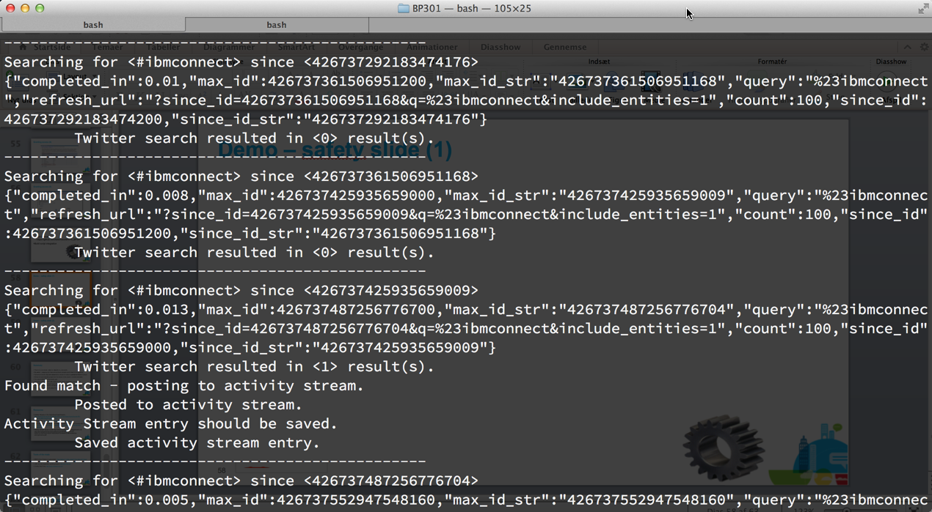
Demo – safety slide (1)

Slide 59
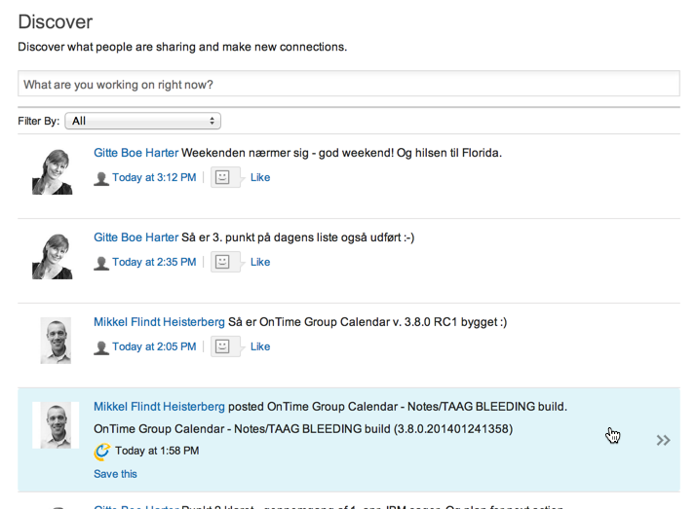
Demo – safety slide (2)

Slide 60
Summary
There’s no one stream - @me vs. @public vs. community
Be patient – wrapping your head around these concepts can be hard in the beginning
Remember that the data isn’t stored in the stream but rather is pointed to from the stream
Entries are automatically purged from the stream unless saved or marked actionable
You cannot delete from the stream (yet)
Accessed using REST API URL based on user, group, application and activity ID
When working with the RESTClient in Firefox use ”Private Browsing” mode as credentials used and cookies returned in one tab doesn’t leak to other ”Private Browsing” tabs.
Pretty easy to use once you grasp the concepts

Slide 61
Resources
Activity Streams in the OpenSocial specification, http://opensocial-resources.googlecode.com/svn/spec/trunk/Social-API-Server.xml#ActivityStreams-Service
AppDev wiki, http://www-10.lotus.com/ldd/appdevwiki.nsf
IBM Connections Activity Stream Integration (AD104 from IBM Connect 2013), http://www.slideshare.net/brianog/ad104-ibm-connections-actiivtystream-integration
Activity Stream hands-on lab, http://www-10.lotus.com/ldd/appdevwiki.nsf/xsp/.ibmmodres/domino/OpenAttachment/ldd/appdevwiki.nsf/82567C415DF5243185257AEE00626F82/attach/5-sdk-workshop-activitystreams.pdf

Slide 62
Tools of the trade
RESTclient in Firefox, https://addons.mozilla.org/da/firefox/addon/restclient/
Advanced REST client in Chrome (issues with POSTs), http://bit.ly/advancedrest
cURL (for any imaginable operating system), http://curl.haxx.se/
Charles Web Proxy, http://www.charlesproxy.com

Slide 63


Access Connect Online to complete your session surveys
But?, How?, Doesn't that mean...
Give it to me! (or come talk to me after the session or find me in the hallways...)
Twitter: @lekkim
Email: mh@intravision.dk
Blog: http://lekkimworld.com

